Slide 1
Image Classification:
IAM Handwriting
Lydia Jin, Xi Qian, Yuyang Wang

Slide 2
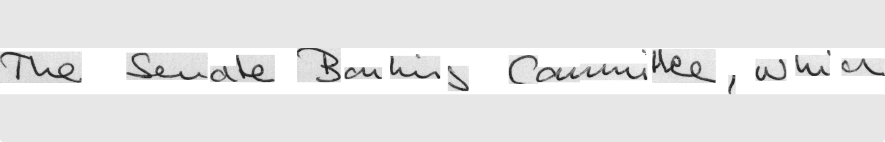
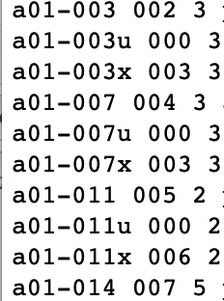
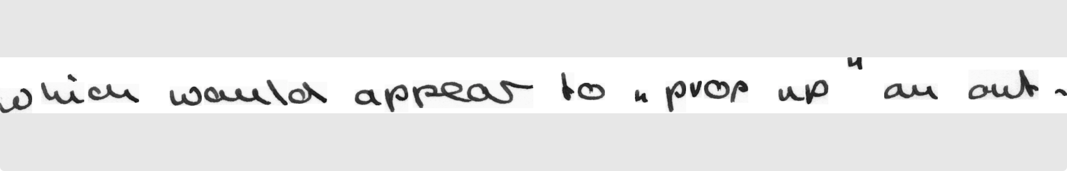
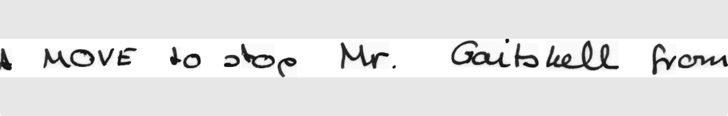
Dataset
Dataset_subset
In total: 4988 number of images
Forms_for_parsing.txt

Slide 3
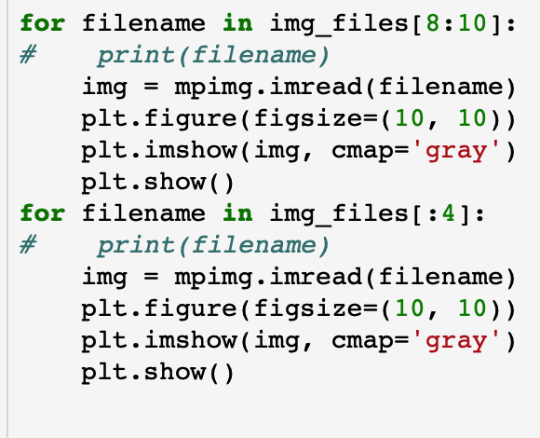
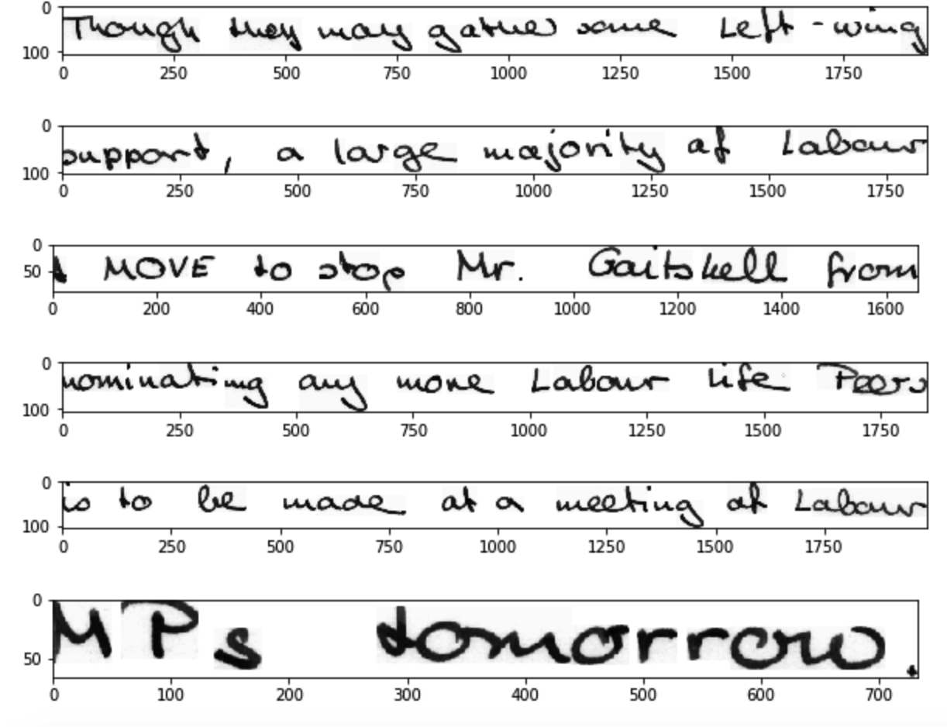
Handwritten scripts by one writer

Slide 4
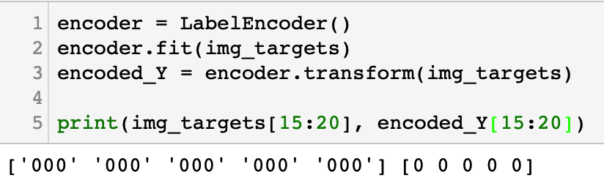

Data Pre-Processing
Label Encode
2.
2. Train, Validation, Test: 7:1.5:1.5

Slide 5
3. Resize

Slide 6
Network Construction
Declares the model type as Sequential().
Add a 2D convolutional layer to process input images
number of output channels
size of moving window
strides in the x and y directions

Slide 7
Network Construction

Slide 8

Network Construction
Flatten the output from these to enter our fully connected
number of output channels
size of moving window
strides in the x and y directions

Slide 9
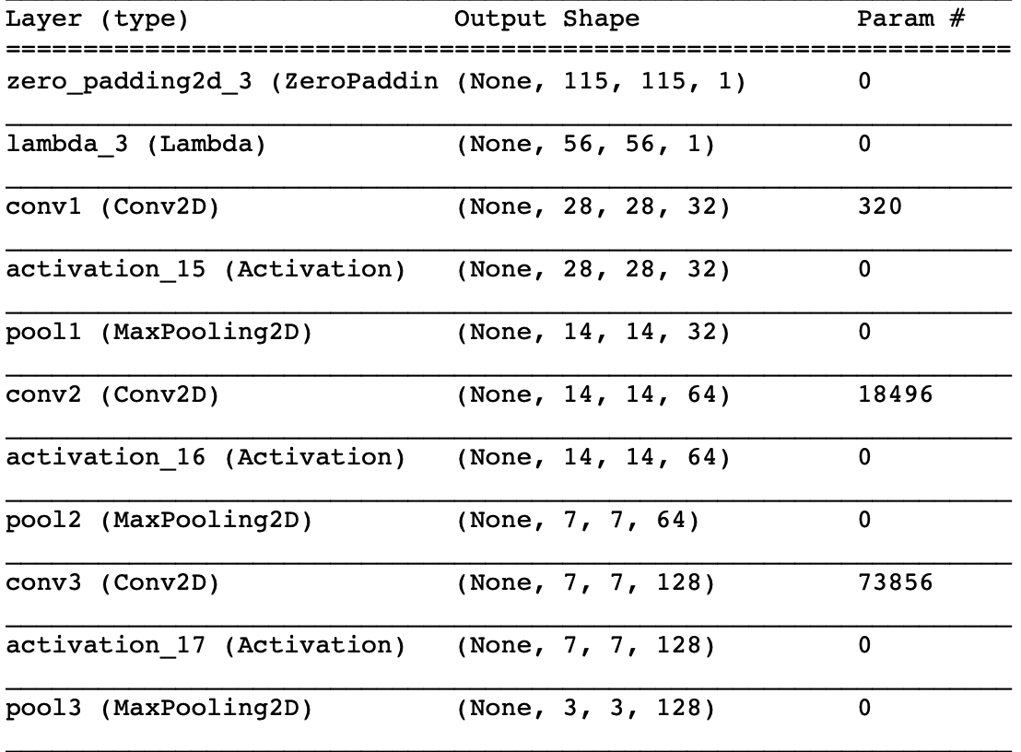
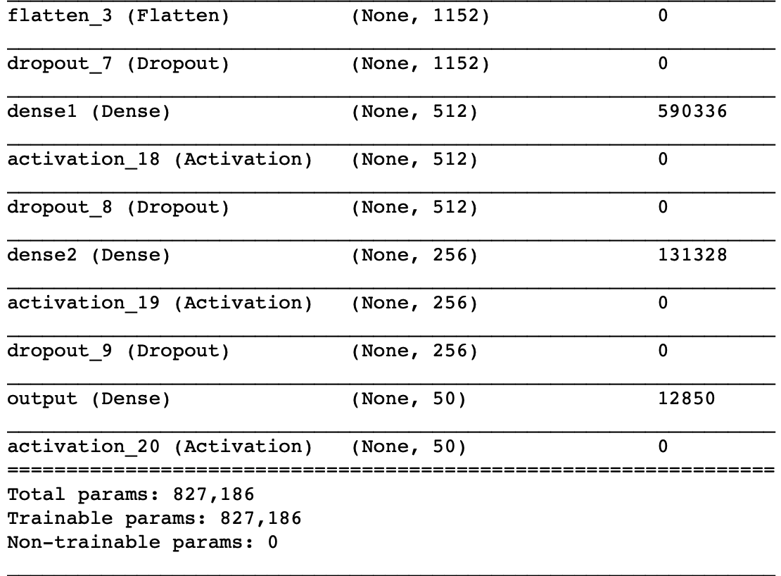
Architecture Network

Slide 10
3-Level CNN (Adam Optimizer) Output

Slide 11
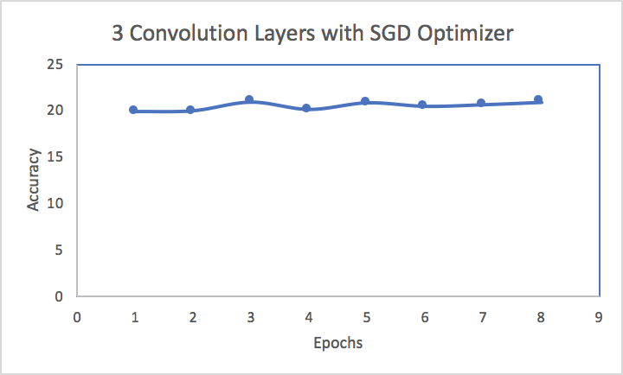
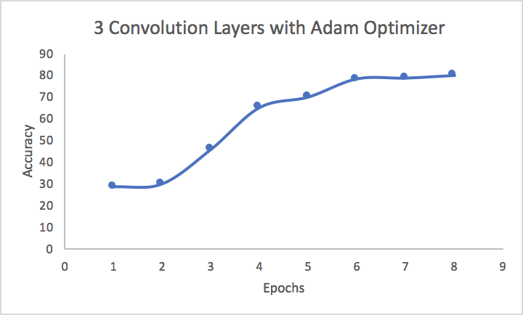
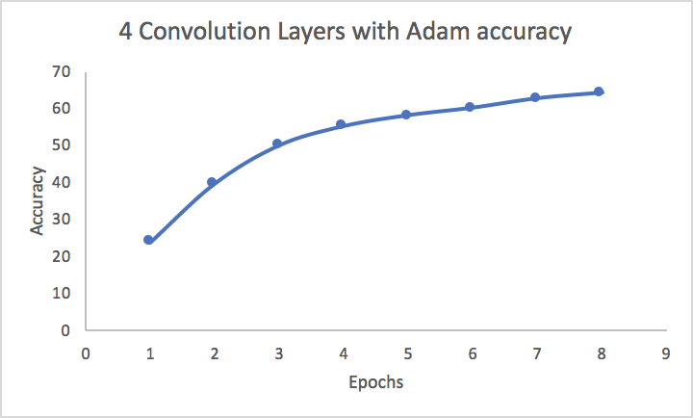
Result

Slide 12
Training Loss Plots

Slide 13
Summary and Conclusion
Keras
Adam & SGD

Slide 14
Questions?

Slide 15
References
Dataset: https://www.kaggle.com/tejasreddy/iam-handwriting-top50
https://www.learnopencv.com/image-classification-using-convolutional-neural-networks-in-keras/
Figure 1: https://towardsdatascience.com/applied-deep-learning-part-4-convolutional-neural-networks-584bc134c1e2
Checkpoint code: https://machinelearningmastery.com/check-point-deep-learning-models-keras/
Generator code: https://www.kaggle.com/tejasreddy/offline-handwriting-recognition-cnn/notebook
CNN Background Information: https://www.learnopencv.com/image-classification-using-convolutional-neural-networks-in-keras/
Save/Load Keras models: http://faroit.com/keras-docs/2.0.2/models/about-keras-models/

